Slide 1

What’s new in SDSF for z/OS 3.2?
Rob Scott
Rocket Software rscott@rs.com @Dadageddon on SZE Discord

Slide 2
Agenda
Summary Of Recent SDSF Enhancements
pysdsf
SDSF Profile Data In zFS
RACF Log Display
Sysname Lists
New SDSF Panels
Useability Enhancements
Miscellaneous Enhancements

Slide 3
Recent SDSF Enhancements
z/OS 2.5
SAF-only security
16 new panels including memory browse, detailed common and private storage information
z/OS 3.1
New concept of SDSF features
Module fetch monitor and event log
Over 30 new panels including RACF classes and profiles
z/OS 3.2
pysdsf
z/OS file system for profile data
18 new panels

Slide 4
pysdsf

Slide 5
pysdsf – Python Interface to SDSF
Easy to use python interface to SDSF
Initial support for the following primary panels
AS, DA, H, I, O, ST
LOG (both SYSLOG and OPERLOG)
Initial support for the following secondary panels
JDS (aka ‘?’), JS
SYSOUT browse supported
Operator commands also supported
Both generated by actions and freeform “/” style

Slide 6
pysdsf – Installation And Setup
pysdsf supplied as part of the standard SDSF SMP/E FMID
Artifacts created via SMP/E APPLY
Wheel file distributed in :
/usr/lpp/sdsf/python/dist/
Documentation distributed in :
/usr/lpp/sdsf/python/doc

Slide 7
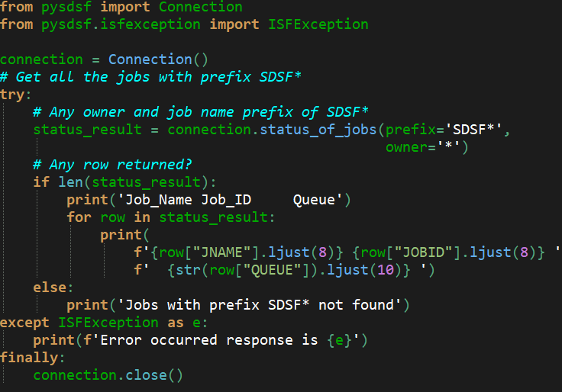
pysdsf – Example Code
Following slides will breakdown the statements to explain the general flow and look-and-feel of pysdsf

Slide 8
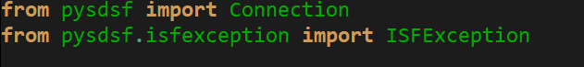
pysdsf – Breakdown Of Statements
Import the pysdsf package and its allied custom exception
pysdsf uses the “connection” object to facilitate communication with the SDSF server
Named SDSF functions can be passed parameters explicitly or set as a dictionary : options = { ‘prefix’:’SDSF*’, ‘owner’:’*’ } status_result = connection.status_of_jobs(**options)

Slide 9
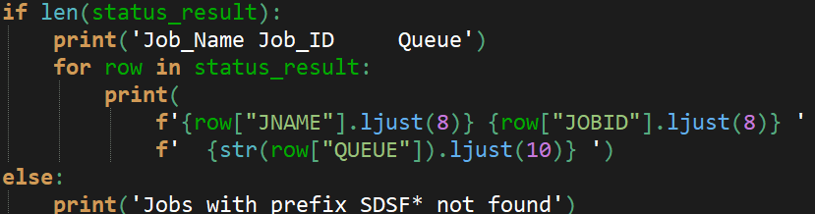
pysdsf – Breakdown Of Statements
Process each row of the results and access column data using the internal column name
Internal column names match SDSF REXX
Handle any exceptions from SDSF
Close the connection with SDSF

Slide 10
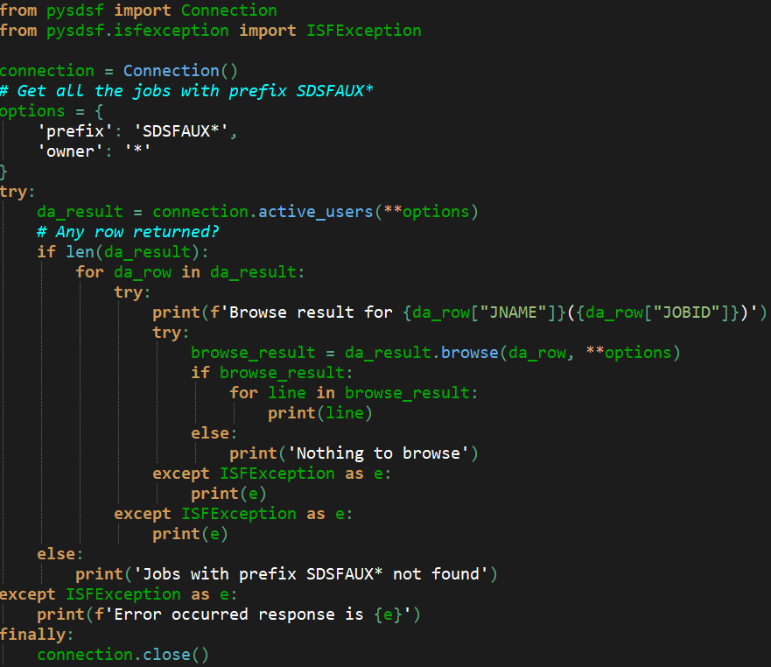
pysdsf – Browse SYSOUT For Active Job
connection.active_users = “DA”
Simple interface to browse SYSOUT for job.

Slide 11
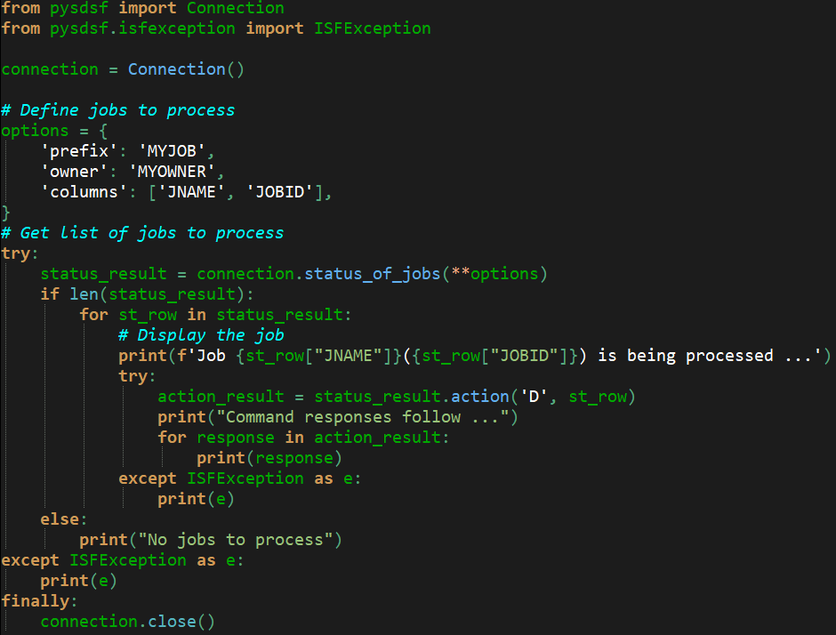
pysdsf – Issue Actions Against Jobname(s)
Simple interface to issue action character against a row
Will result in z/OS operator command being issued and we can examine the response

Slide 12
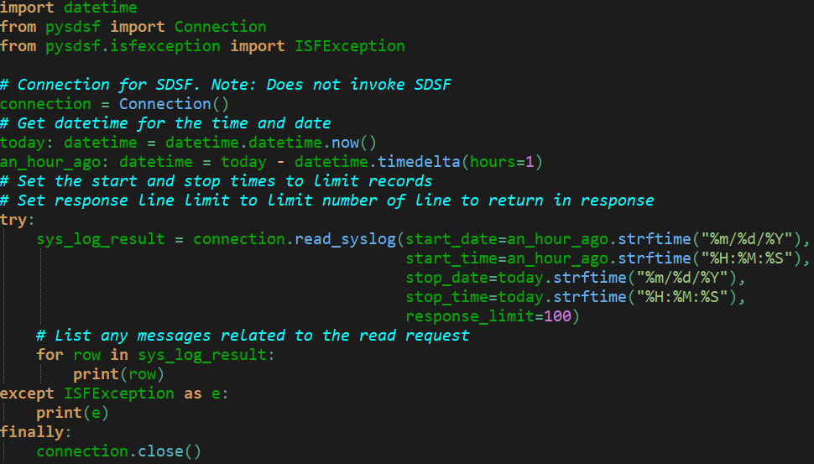
pysdsf – Scanning the SYSLOG/OPERLOG
Simple interface to browse and process SYSLOG rows

Slide 13
pysdsf – Initial Function List
active_users DA panel
address_space_memory AS panel
browse SYSOUT browse
held_output_queue H panel
input_queue I panel
issue_command “/” facility
output_queue O panel
read_syslog/read_operlog LOG panel (SYSLOG/OPERLOG)
status_of_jobs ST panel

Slide 14
SDSF Profile Data In zFS

Slide 15
SDSF Profile Data in ISPF - Restrictions
SDSF for z/OS 3.1 and prior releases use ISPF profile to store user settings, preferences including sort, arrange and filter criteria
ISPF has a fixed limit of 64K for all data within a single xxxxPROF member of the ISPPROF data set
SDSF users with large amounts of sort, arrange or filter criteria can exceed 64K in size causing errors when trying to VREPLACE/VPUT data into ISFPROF
Using ISPF for profile data also means that other interfaces cannot retrieve stored user settings

Slide 16
SDSF Profile Data in zFS
SDSF for z/OS 3.2 introduces the ability to store user profile data in the z/OS UNIX file system
Removes the 64K data limit constraint
Makes profile data available to non-ISPF interfaces
Profile data stored as JSON documents
Positions SDSF to provide further enhancements in later releases based on the JSON document profile store

Slide 17
SDSF Profile Data in zFS Implementation
New SDSF group keyword “PROFILE”
ISPF Use legacy ISPF profile (default)
FILESYS Use z/OS UNIX file system
Profile data stored in the “.isf” directory in user home directory
New SDSF group keyword “PROFILEPATH”
Specifies any additional directory path appended after “.isf”
Default is null
Invocation screen name appended to directory name if not equal to “SDSF”
Allows users to have different profile stores for fastpath SDSF invocations from places like the ISPF command table

Slide 18
SDSF Profile Data in zFS Migration
SDSF profile path will be created if does not exist and any existing ISPF profile settings will be automatically migrated to new JSON format
Users can re-migrate by deleting the “.isf” directory and re-invoking SDSF
Once the SDSF profile path is created, any existing or updated ISPF profile settings will be ignored
Data will not be saved to ISPF profile members after migration
Important to note if sharing SDSF ISFPROF members with downlevel systems
SDSF for z/OS 3.1 and below will have no knowledge of profile data in the profile path filesystem
Some customers might postpone using FILESYS profiles until all members in sysplex are at least z/OS 3.2

Slide 19
SDSF Profile Data Considerations
SDSF users should not edit the JSON documents in the “.isf” profile directory
Any malformed or invalid JSON data encountered during initialization will cause SDSF to discard all profile path information and fall back to using default settings

Slide 20
RACF Log

Slide 21
RACF Log Panel
New RLOG panel
Provides a summary of recent logged RACF activity
Includes failures and logged access for traditional resources as well as certain z/OS UNIX information
Uses the SDSF event log architecture to provide the data
SMF record type 80 contents used to populate panel entries
Drill down to the OPERLOG from row on RLOG panel using “L” action
Saves hunting OPERLOG for ICH408I messages
Direct access to profile information and access list using “LP” and “LA” actions
RLOG panel can be filtered using FEATENT statements in similar fashion to ELOG
New categories of “SAF”, “SAF_CMD” and “SAF_UNIX”

Slide 22
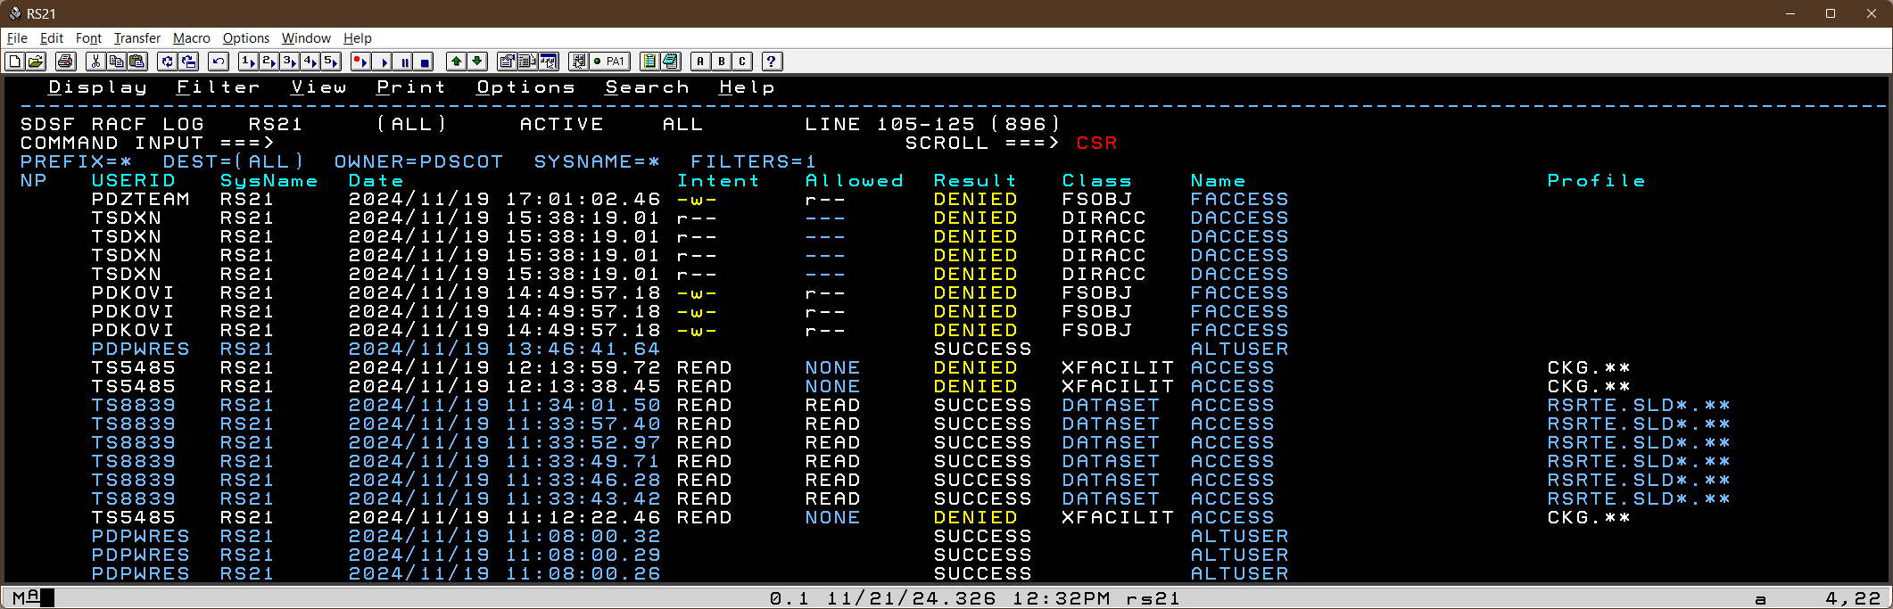
RACF Log Panel
Both traditional and z/OS UNIX access events are displayed

Slide 23
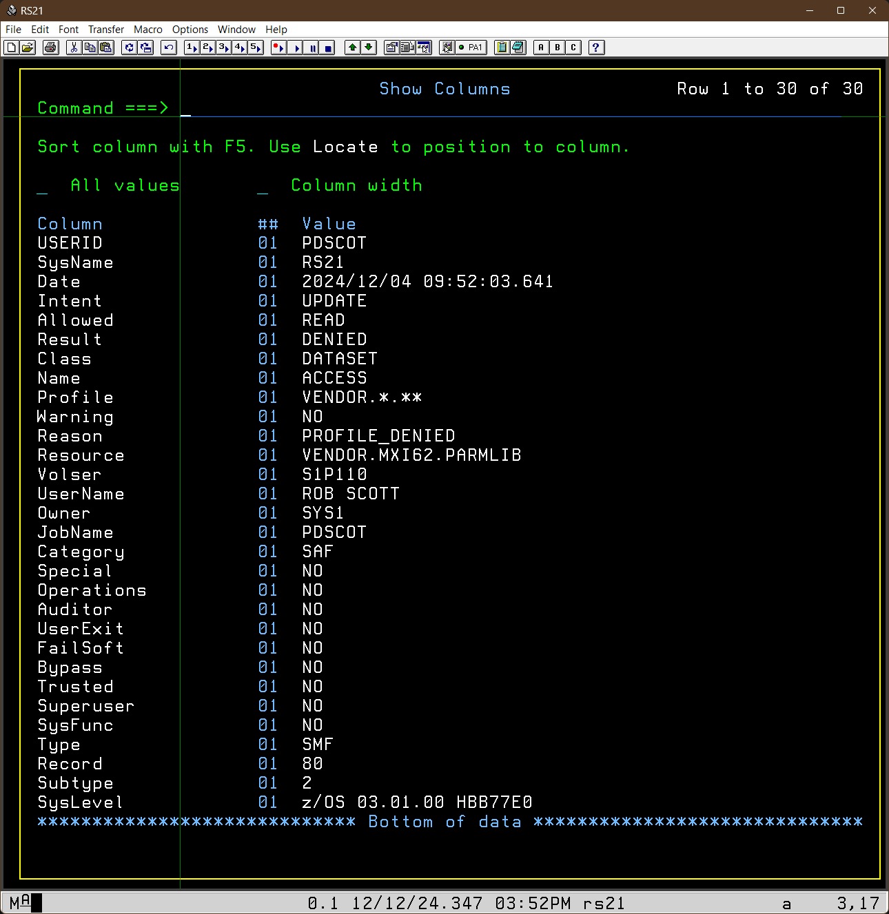
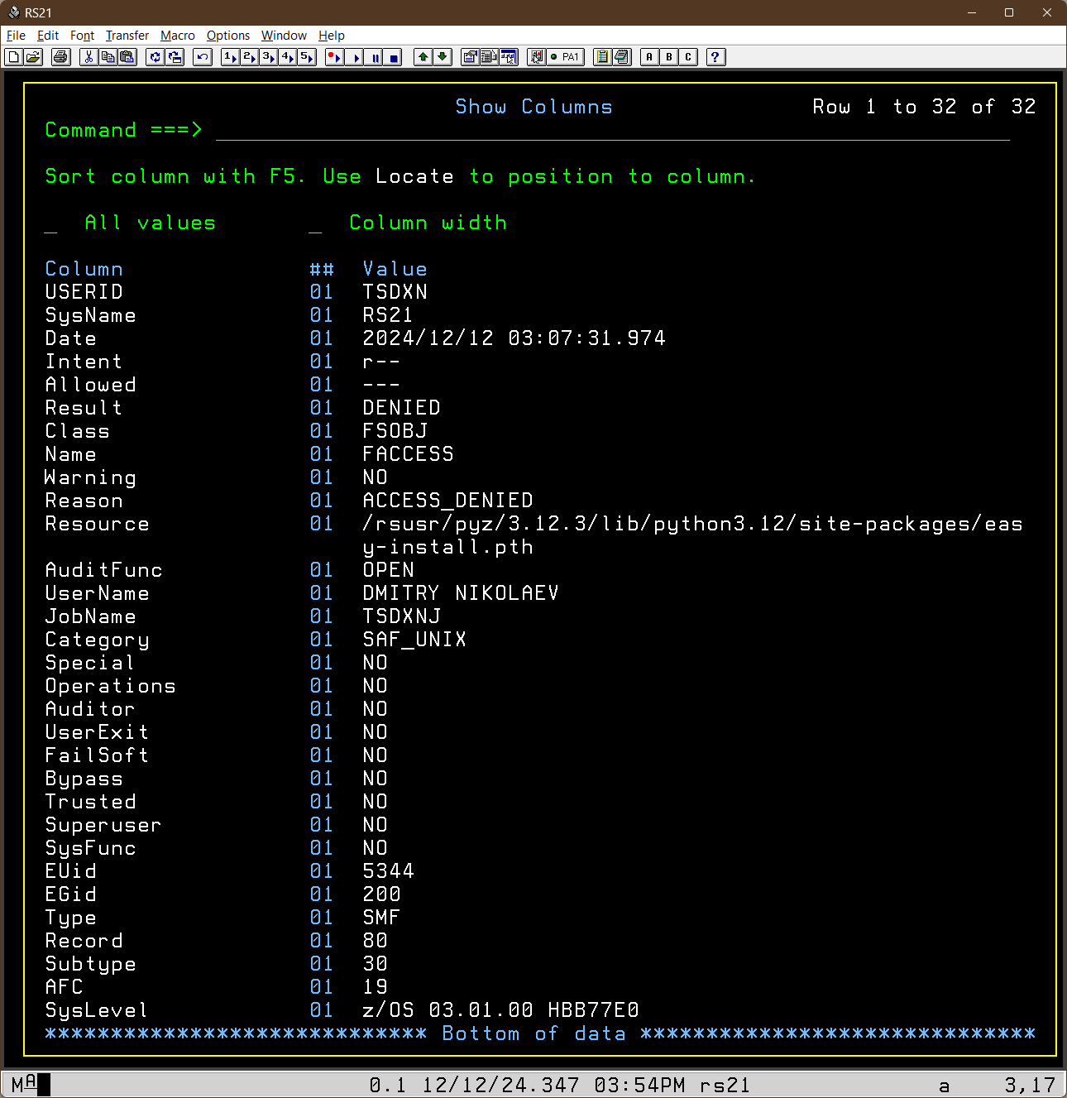
RACF Log Panel - Detail
SDSF “Show” panel of both a traditional DATASET class event and a z/OS UNIX event.

Slide 24
RACF Log Panel -Columns
Columns include
Class, resource and profile
Jobname, User name, application name and owner
Access intent and allowed
Warning, special, operations, auditor, failsoft, bypass, trusted attributes in effect
Any z/OS UNIX EUID and EGID
Any log string data and RECVR
Any SECLABEL
Names for any attempted RACF commands

Slide 25
RACF Log Panel - Actions
L
Invoke LOG (OPERLOG) panel and position to the date-stamp of the logged event
LA
Show the RACF access list for the profile covering the resource in shown in the row
LP
Browse the RACF profile covering the resource in shown in the row

Slide 26
Sysname Lists

Slide 27
SDSF Sysname – Problem Statement
Cross-system data gathering with a sysplex governed by the SYSNAME setting for the current user
If not null and not equal to local sysname, data-gathering request is broadcast to all systems matching the SYSNAME pattern using XCF signalling services
Sometimes groups of z/OS systems in a sysplex do not follow naming standards that can be easily masked using “*” and “%”
Users frequently run with SYSNAME set to “*” and then use filtering on the SYSNAME to discard unwanted rows
Increased overhead for data gathering on unnecessary systems
Increased chance of “missing data” situation for test systems or systems under stress

Slide 28
Sysname Lists - Implementation
New ISFPRMxx statements LIST and LISTENT
LIST statement declares the name and type of the defined list
LISTENT statement declares the list items for the current list
Assuming three systems “PROD”, “DEV” and “TEST” in a sysplex
LIST NAME(XTEST) TYPE(SYSNAME)
LISTENT NAME(PROD)
LISTENT NAME(DEV)
User can issue “SYSNAME XTEST” and data gathering requests will be sent ONLY to “PROD” and “DEV”
SET DISPLAY ON will show “/L” appended to SYSNAME setting to indicate that a sysname list is being used
Can also be used in the RSYS command to filter WTORs shown on LOG panel
SR panel can also take advantage with custom property : Panel.SR.EnableRsysFilter

Slide 29
Other New SDSF Panels

Slide 30
New SDSF Panels
AW Active Job Summary By WLM Class
CAT Master And User Catalogs
CMO 64-bit Common Memory Objects
DEVS Device Space
FXE z/OS Function Registry
JRU JES2 Resource Usage by Userid
MFP z/OS UNIX Path Module Fetch
NAP TCP/IP Activity Summary By Port
PST z/OS UNIX Threads
RACD RACF Data Sets
RACF General RACF Information
RACR RACF RRSF Nodes
SMFL SMF Logstreams
SMFR SMF Real Time Resources
VTOC DASD Volume Table Of Contents

Slide 31
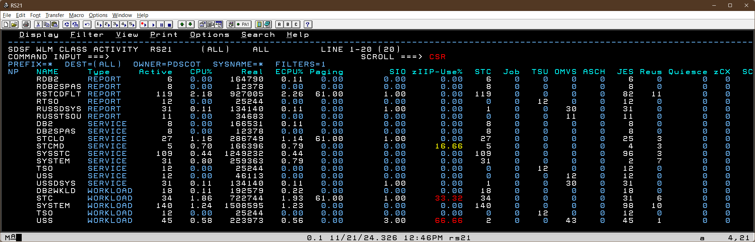
AW Panel – Address Space Summary By WLM Class
A row for each WLM class that has at least one qualifying jobname active
User can drill down to DA panel using “L” action to filter by WLM class name
Optional keyword on AW command to filter rows by WLM class type or “ALL”

Slide 32
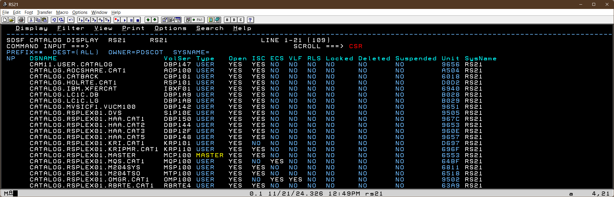
CAT Panel – Master and User Catalogs
User can issue variety of CATALOG operator commands as action characters on the row to lock and unlock, suspend and resume

Slide 33
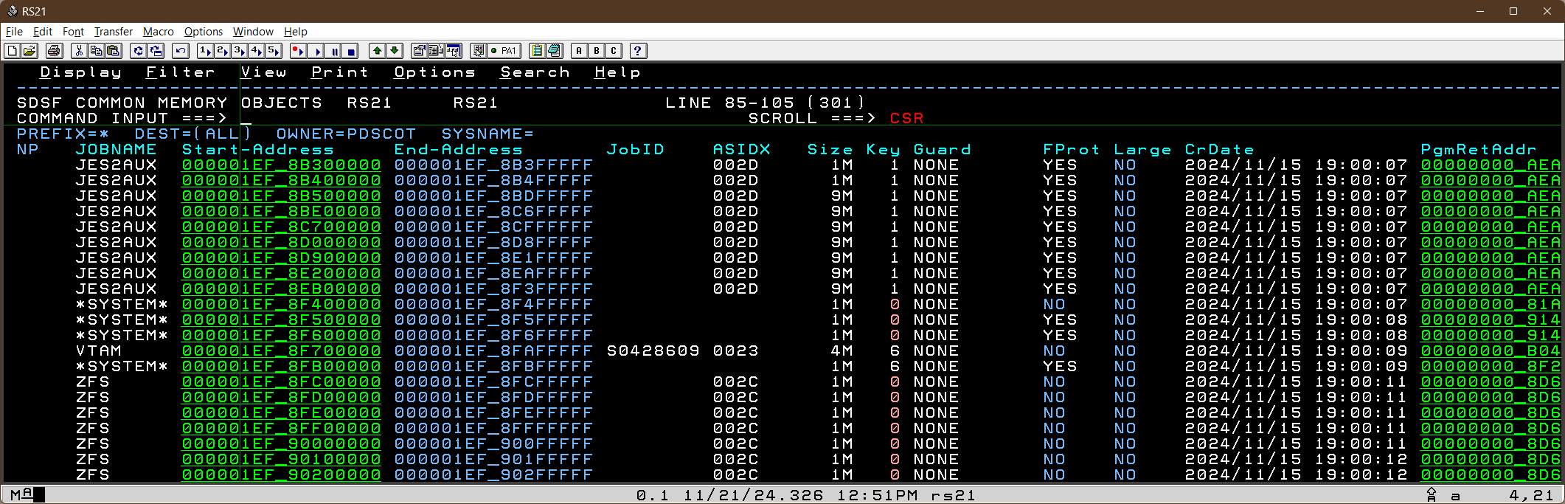
CMO Panel – 64-Bit Common Memory Objects
Every HV-COMMON memory object shown in ascending address sequence
Includes tracking information such as date-stamp and ASIDs in effect at creation
Panel also includes real frames and aux slots backing each memory object

Slide 34
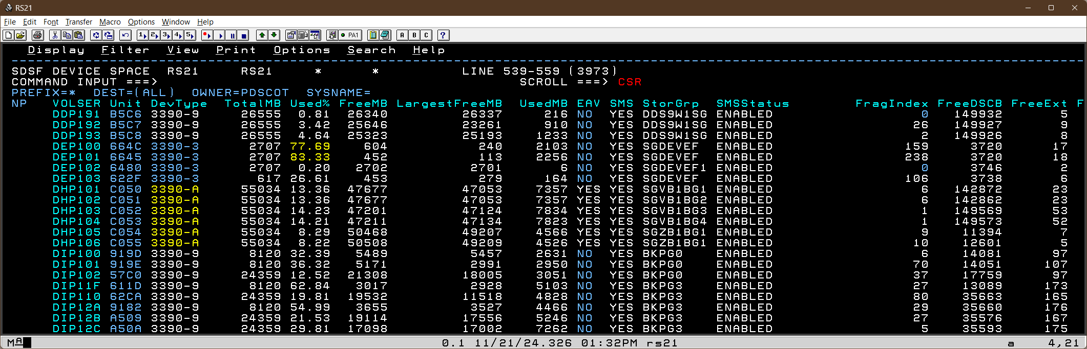
DEVS Panel – Device Space
Both SMS and non-SMS DASD volumes shown
Statistics and status from VTOC displayed in various columns
Optional keywords can filter on volser and/or storage group patterns

Slide 35
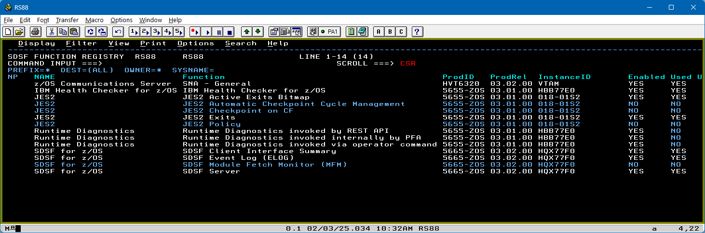
FXE Panel – z/OS Function Registry
SDSF now reports on and participates in the function registry
User can “browse” a FXE entry using the “s” action against the row

Slide 36
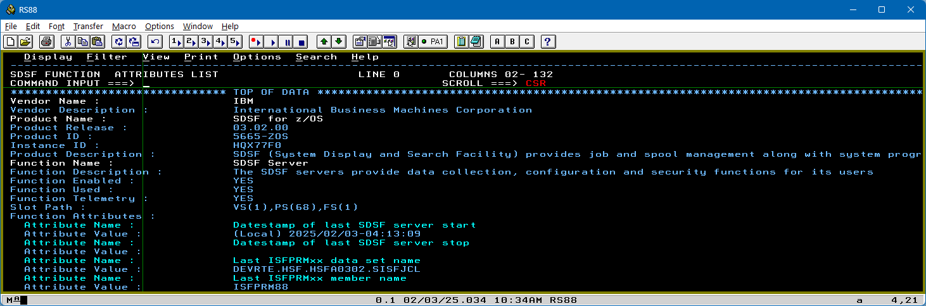
FXE Panel – z/OS Function Registry Browse
The FXE browse shows all product and function attributes and their values

Slide 37
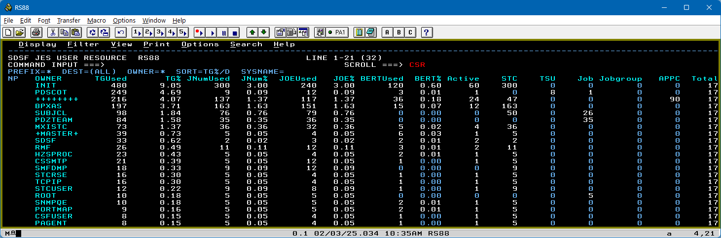
JRU Panel – JES2 Resource By Userid (Owner)
Critical JES2 resources summarized by the owning userid
Point-and-shoot on OWNER will invoke SDSF “ST” panel filtered by the owning userid allowing actions like cancel/purge

Slide 38
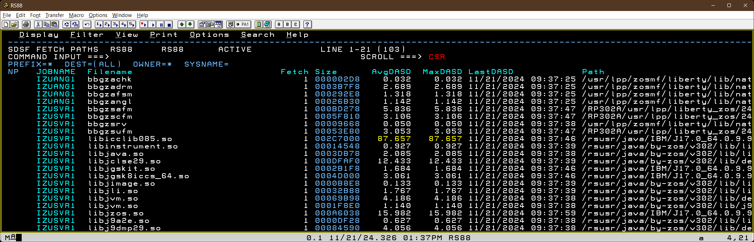
MFP Panel – Module Fetch UNIX Path
Module fetch monitor enhanced to show fetches from z/OS UNIX paths
SDSF separates the filename from the lowest directory in the path to make it easier to distinguish the entry
Full path name up to 1024 characters can be seen on the SDSF “show” panel

Slide 39
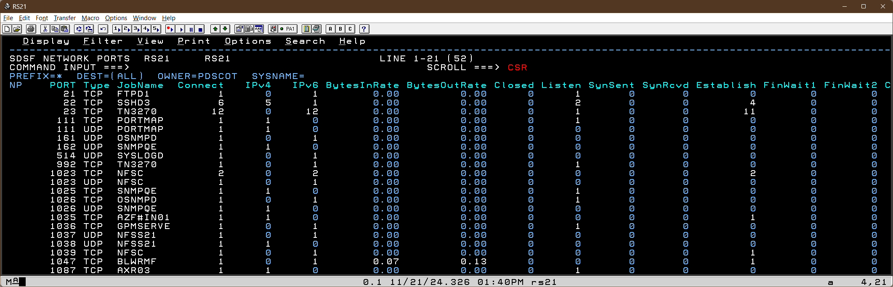
NAP Panel – Network Activity By Port Number
Network activity summarized by port number
User can drill down to the NA panel filtered by port number using the “L” action on the row

Slide 40
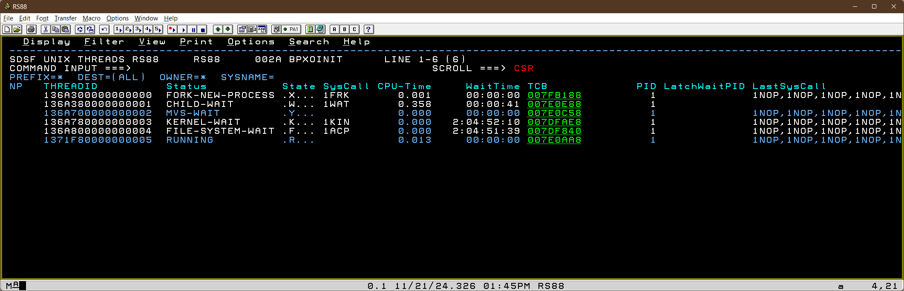
PST Panel – z/OS UNIX Process Threads
The “LT” action on the PS panel shows all threads for a specific z/OS UNIX process

Slide 41
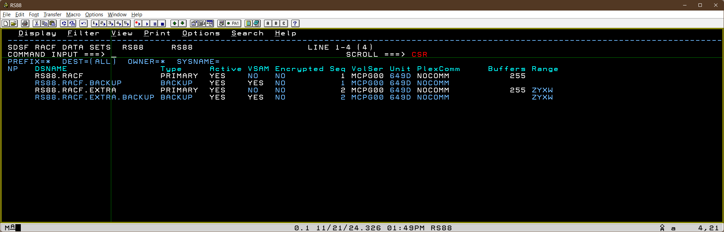
RACD Panel – RACF Data Sets
RACF data sets panel includes columns for whether data set is VSAM and encrypted
Any associated range table is also shown with character and hex values

Slide 42
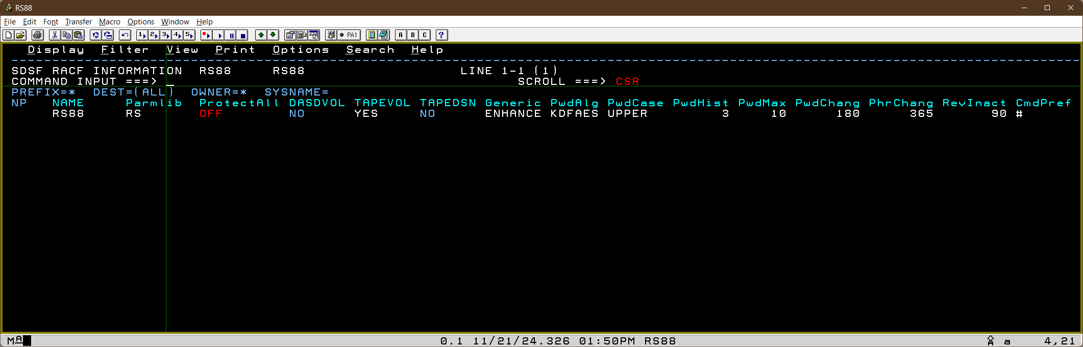
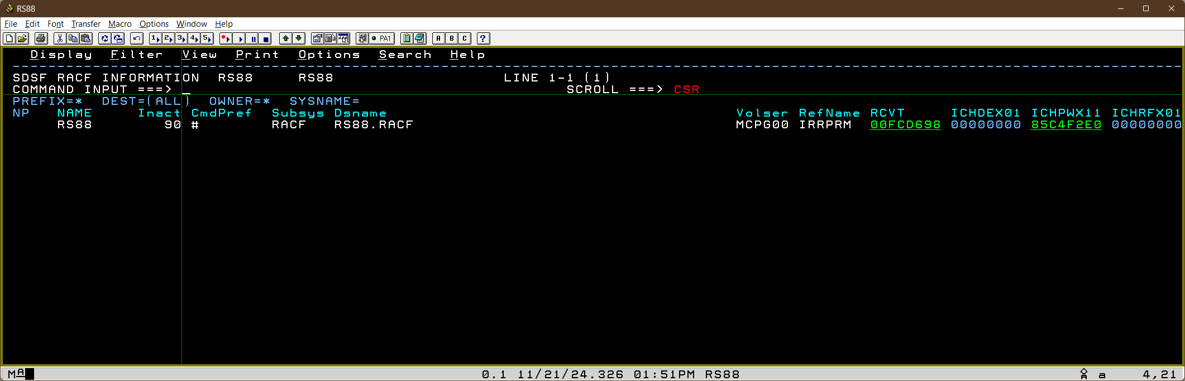
RACF Panel – General RACF Information
General RACF information shown including known exit point addresses
The “LCK” action will show the IBM healthchecks for RACF

Slide 43
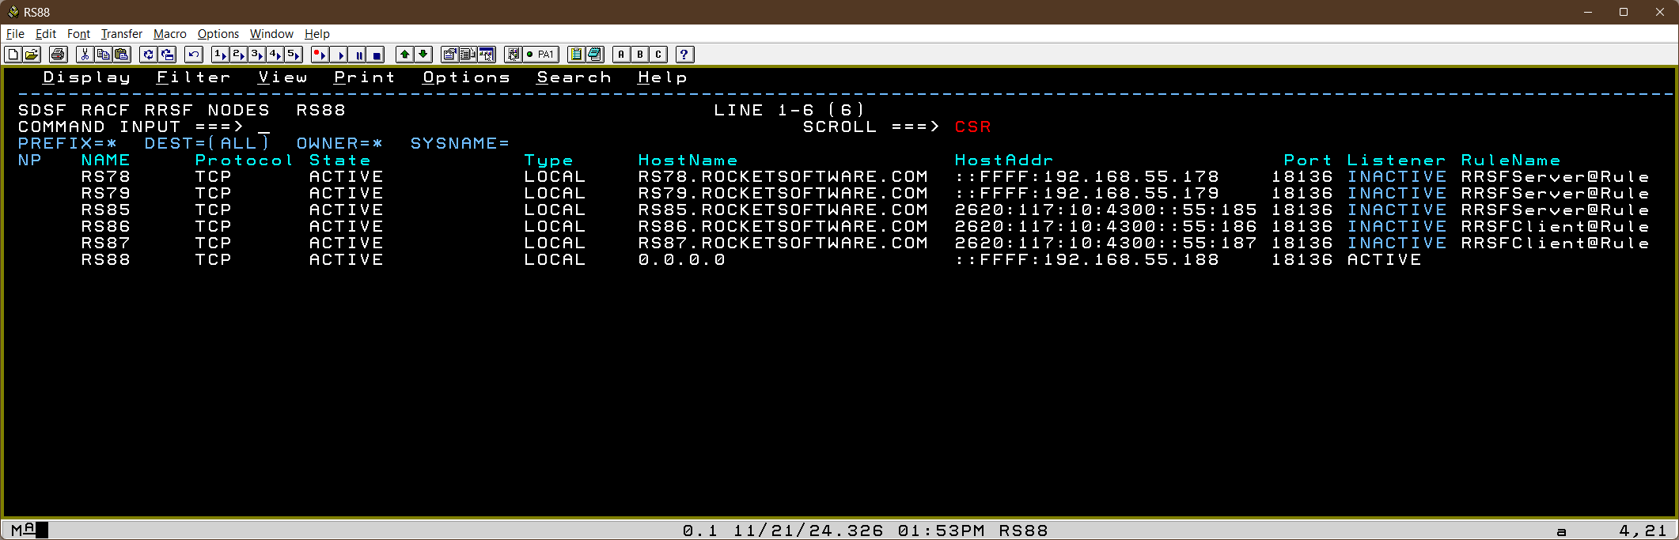
RACR Panel – RACF RRSF Nodes
All RRSF nodes are displayed including statistics about messages sent between them
Various actions against the row will issue the associated RRSF TARGET commands for the nodes

Slide 44
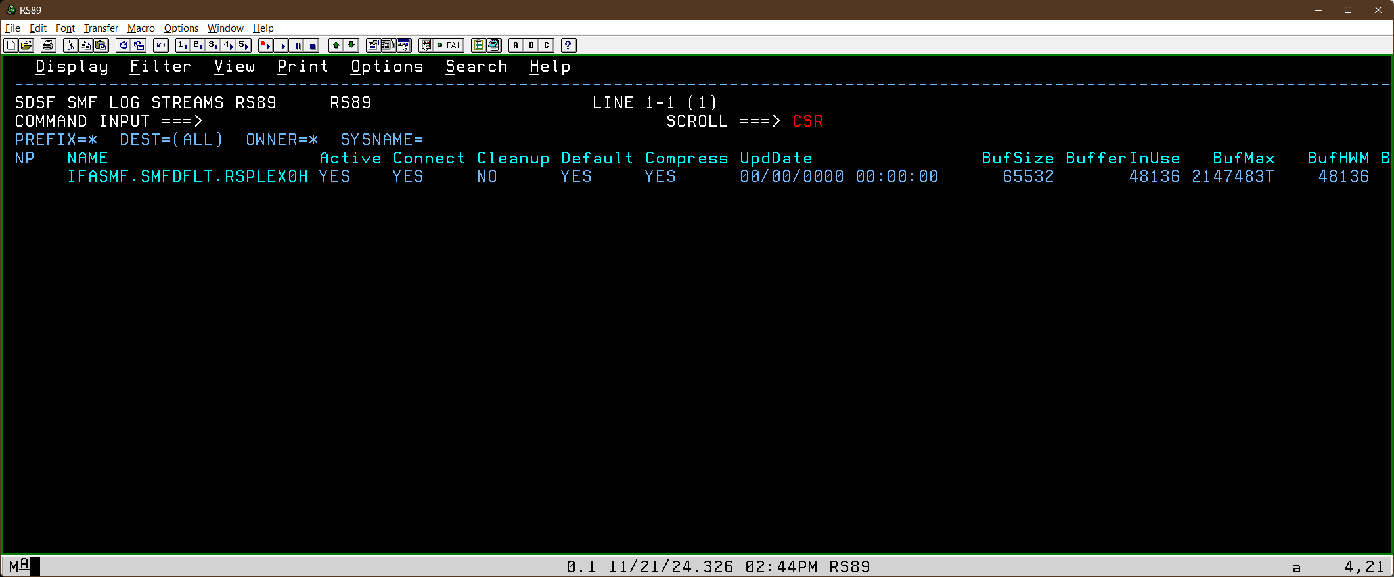
SMFL Panel – SMF Logstreams
All SMF logstreams shown including information about buffer size and usage

Slide 45
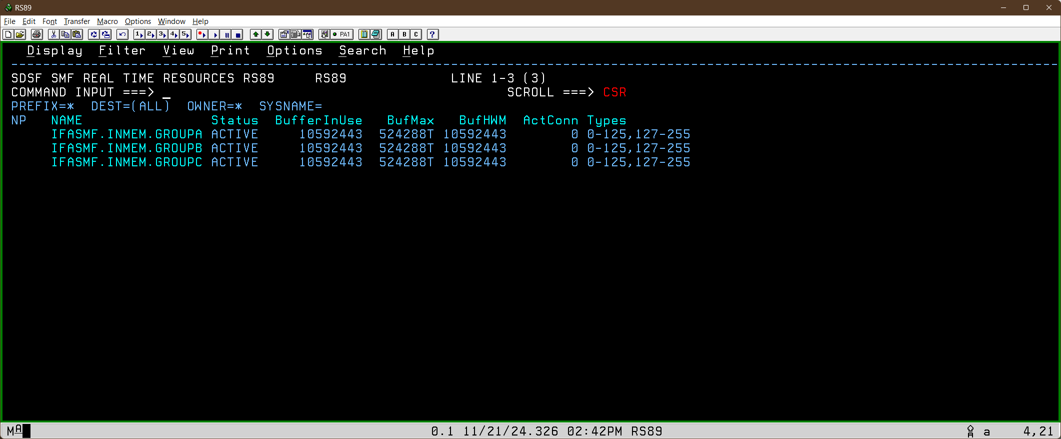
SMFR Panel – SMF Real Time Resources
All SMF real time resources shown including record types and buffer usage statistics

Slide 46
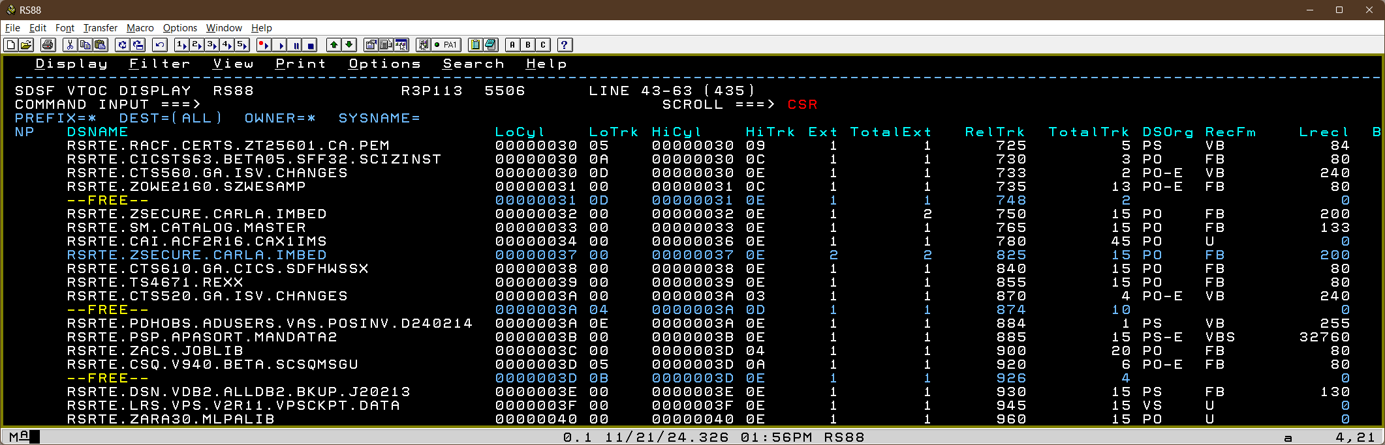
VTOC Panel – DASD Volume Table Of Contents
SDSF can now map a DASD volume VTOC
Each extent of a data set is shown (primary extents highlighted)
Free extents and the VTOC itself shown as special rows

Slide 47
Useability Enhancements

Slide 48
Action Prompt Panel
New concept of SDSF “control” action char of a single dot “.”
Used in a couple of new enhancements
Common action character across all tabular panels
Using the characters “./” in ISPF against a row will now cause a pop-up panel showing all actions defined for the panel in a scrollable list
User can select entry to apply the action to the row(s)
No longer need SET ACTION ON to see available actions

Slide 49
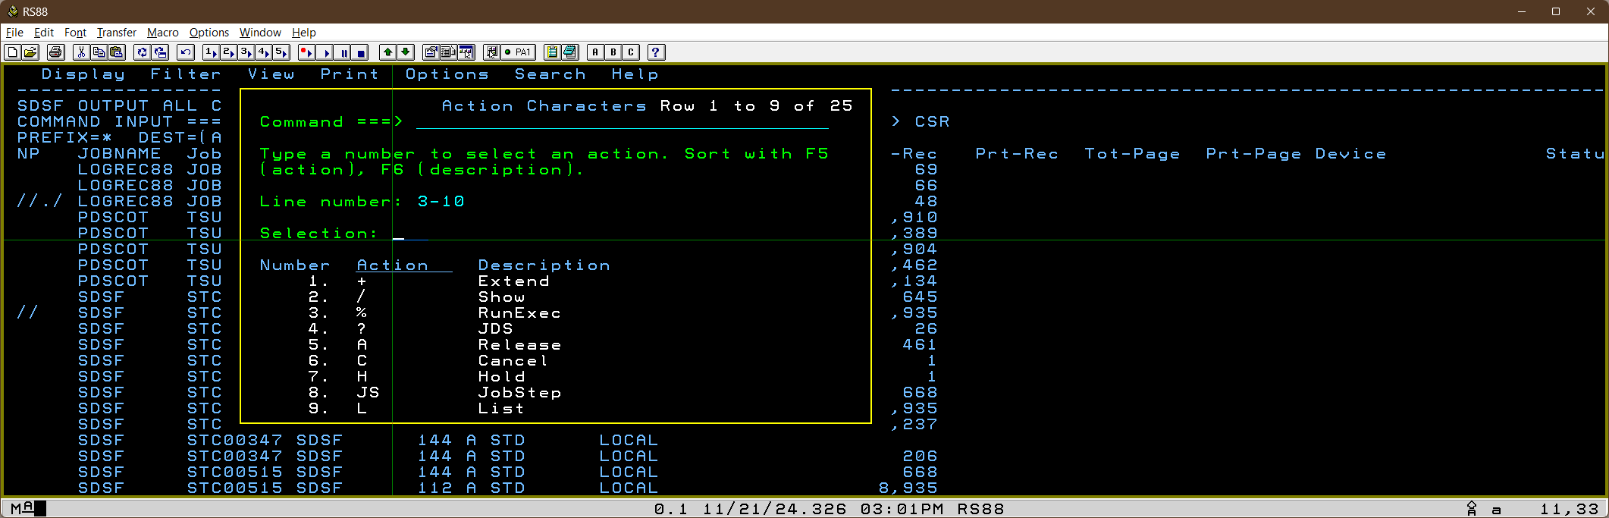
Action Prompt Panel
Can be applied to block range as well as single row
Selection applied to all rows

Slide 50
MGRP Panel - Main Menu Group
Groups SDSF commands by their associated group name
Allows user to expand or collapse individual groups to show associated commands
Expand/collapse status of each group saved in user profile
Use “.” to expand and “..” to collapse
MGRP command can be issued anywhere within product
Use SET MAIN GROUP command to have this as the default SDSF main menu

Slide 51
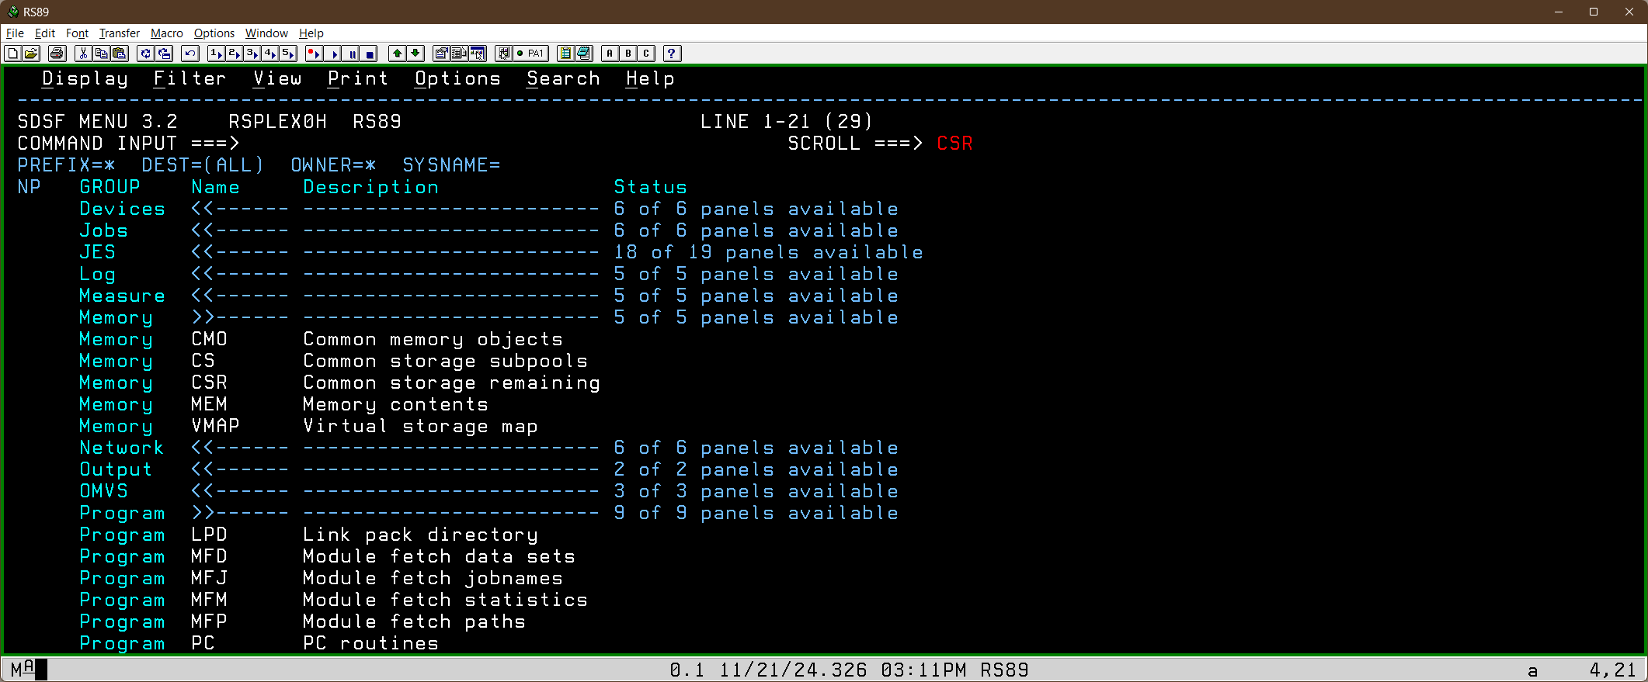
MGRP Panel - Main Menu Group
Both the “Memory” and “Program” groups have been expanded using the “.” action
Status column shows the number of panels that user can use within the group

Slide 52
Miscellaneous Enhancements

Slide 53
Common Action Characters
Several new common actions across multiple panels
LCK
Lists health checks for the associated component for the row object
Panels include APF, CFC, FS, JES, LNK, RACF, VMAP
LE
Lists WLM enclaves for row object
Panels include AD, AS, AW, DA, REPC, RGRP, SRVC and WKLD
LVT
Invokes the DASD VTOC panel for the volser in the row
Panels include CAT, DEV, DEVS, SMSV
LA and LP
List RACF profile/access for resource protecting the data in the row
Panels include APF, CAT, JDD, LNK, PARM, RLOG
Point and shoot on ULOG SECTRACE entries invokes LA action

Slide 54
Notable New/Updated Columns On Existing Panels
AUTOMNT and PDevice on FS panel
NoTypes column on SMFS
zCX column on AD, AS and DA to indicate running container extensions
Executable memory indicator on JM detail panel
MemLimChg on AS to show how much 64-bit memory is actually charged towards the address space MEMLIMIT value.
Extent and EffExtent on LLS panel
Enables monitoring of link list data set extents
Extent is number of physical extents for the data sets
EffExtent is the effective extents when considering that PDSE data sets count as single extent for link list regardless of physical extents

Slide 55
Systems Programmer Task Assistant Dialogs
Post-GA APAR PH67610
Rolled back to SDSF for z/OS 3.1
Adds ISPF dialogue panels to guide user through common sysprog activities
Add/remove data set within APF list
Add/remove link list sets
Add/remove data set within link list set
Activate/Update link list set

Slide 56
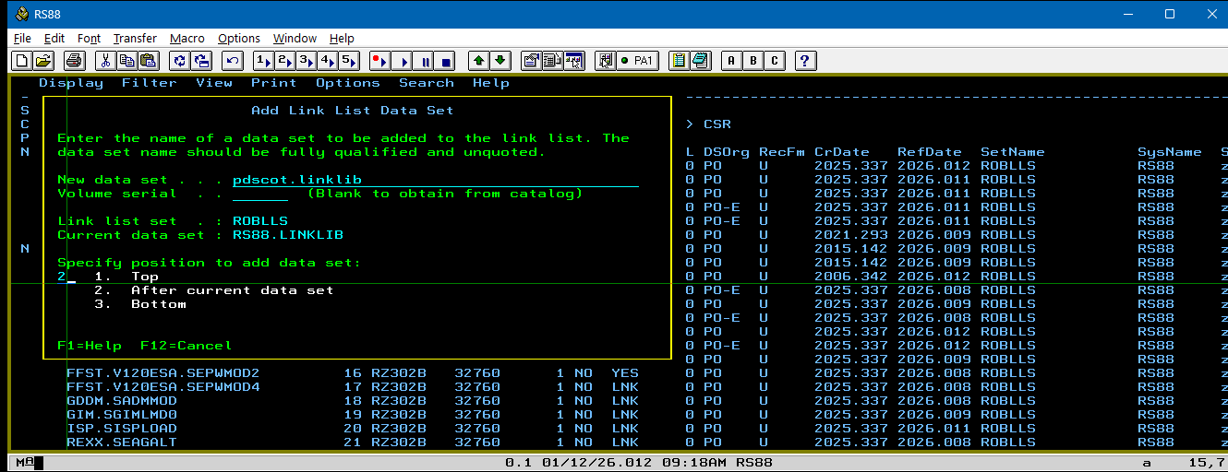
Systems Programmer Task Assistant Dialogs
L action on PS
Will show (via SDSF browse) the full command text for a z/OS UNIX process
Post-GA APAR PH67610
Also rolled back to z/OS 3.1
Adds ISPF dialogs for common systems programmer actions
Manage APF data sets
Manage Link List sets
Manage Link List data sets

Slide 57
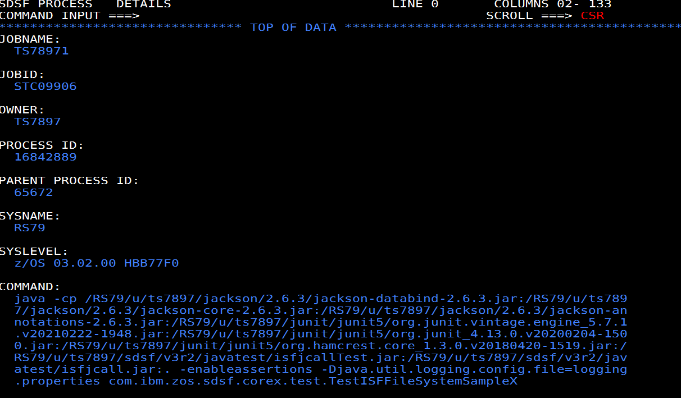
Other Enhancements
L action on PS
Will show (via SDSF browse) the full command text for a z/OS UNIX process

Slide 58
Other Enhancements
Programmer name on I, O, H and ST is no longer a delayed field
Will need JES2 $ACTIVATE level of Z32
Resolves long-standing requirement and performance improvement
Long fields on SHOW panel
The SDSF show action “/” pop-up panel will display all characters for very long field data, for example z/OS UNIX paths
Characters will be continued on multiple lines in the scrollable area

Slide 59
For more SDSF presentations :
github.com/IBM/IBM-Z-zOS/tree/main/zOS-Education/

Slide 60
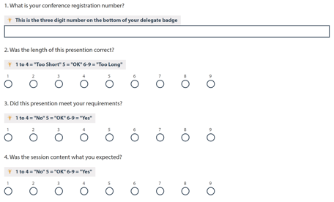

Session feedback
Submit your feedback using the Whoova app or at the conference website - https://conferences.gse.org.uk/2025/feedback/HL
Make sure you are signed into Whoova
app or MyGSE if using the website
The session code is HL

Slide 61
New SDSF functions in z/OS 3.2
Rob Scott
rscott@rs.com

